Slide 1
19 Oct 2020 – Sprint 04 and Demo day
Logan St. Cyr
Justin Figueredo
Lucas Nieddu
Victoria Crowley

Slide 2
Previous Sprint
With our team fully integrating internal components, we found that the data transmission between our ground station and the transmitter more frequently dropped packets of data than what the team determined to be acceptable. Corrected with a Python Library.
MAJOR DELIVERABLE for this sprint through the integration of a logger application to check for files
Research size and shape requirements for the payload, determine the most efficient way to integrate the sensors into the CPU
MINOR DELIVERABLE for this sprint, as the CubeSat team is preparing for launch on Oct 31st

Slide 3
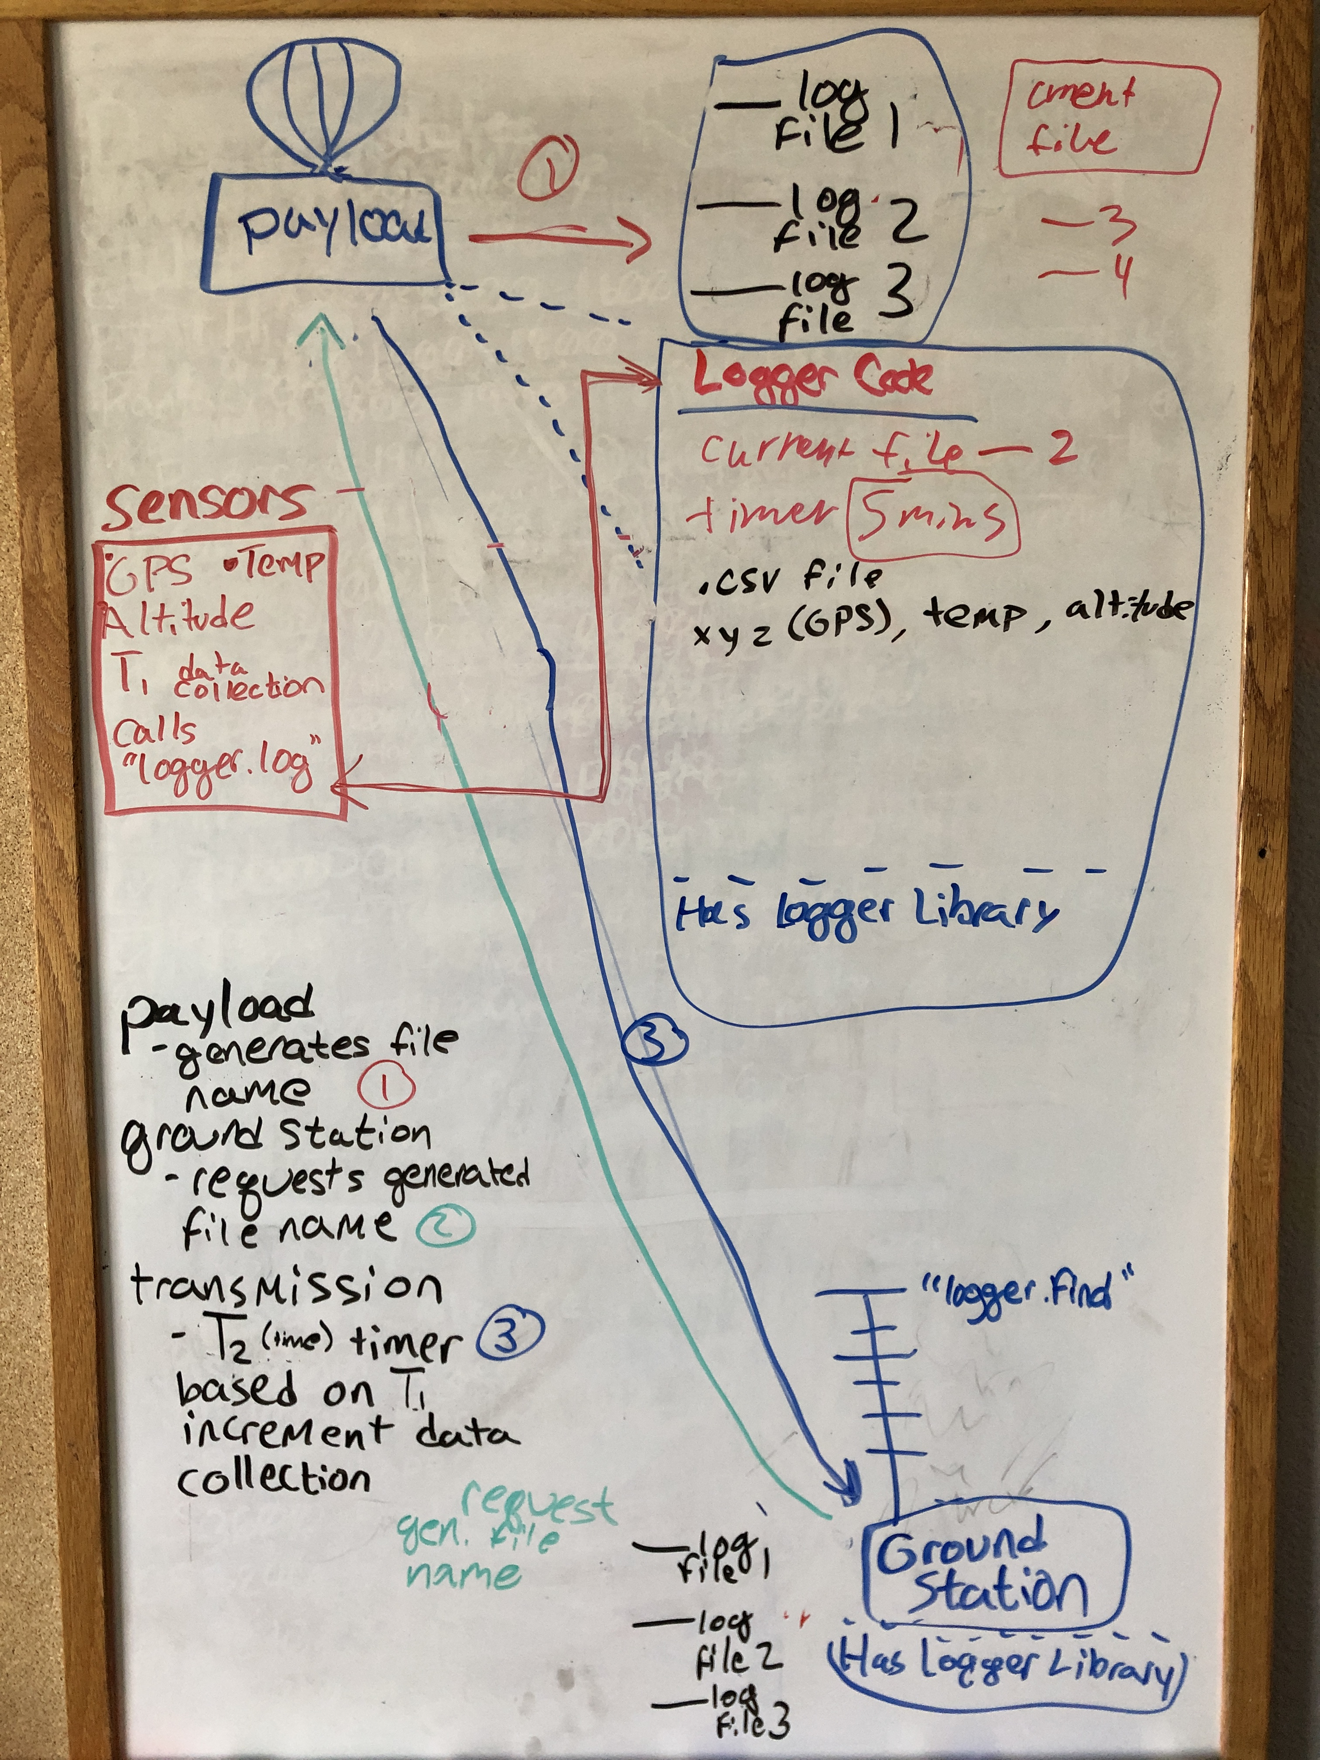
Current Sprint
Purpose: Deliver the payload to the AES department in preparation for the October 31st launch. By the 27th of October, the team should be prepared to deliver the payload to Randy Owen and the EOSS team
To ensure that we could check for strings of data, Justin and Lucas developed a logger based on a time requirement

Slide 4
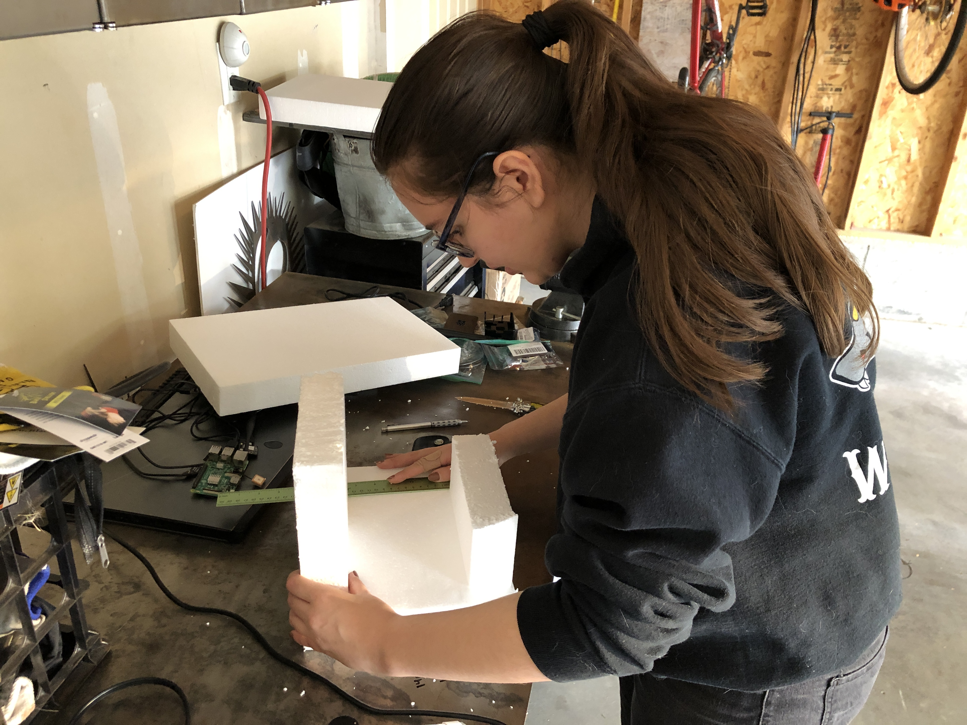
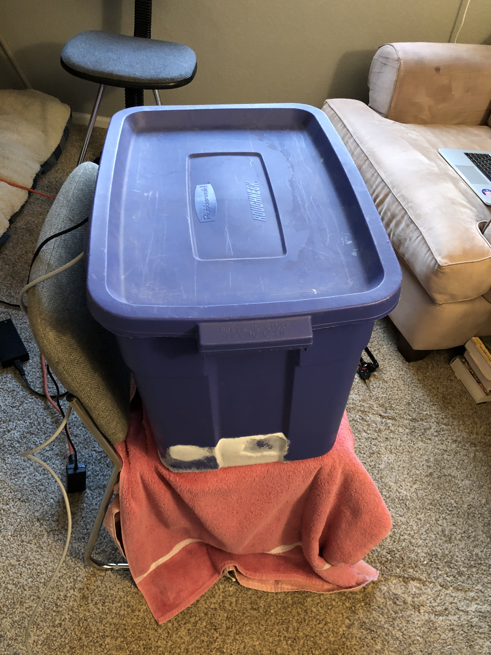

Payload Design and Testing
Raspberry pi
Listed Operating Environment Temperature: 0$°C$ to 50$°C$
Tested Operating Environment Temperature: -100$°C$ to 50$°C$
Our team is primarily concerned with the minimal temperatures the unit will be exposed to, and so the team tested that using dry ice
RFD900x
Listed Operating Environment Temperature: -40$°C$ to 85$°C$
GPS Module
Listed Operating Environment Temperature: -50$°C$ to 80$°C$

Slide 5
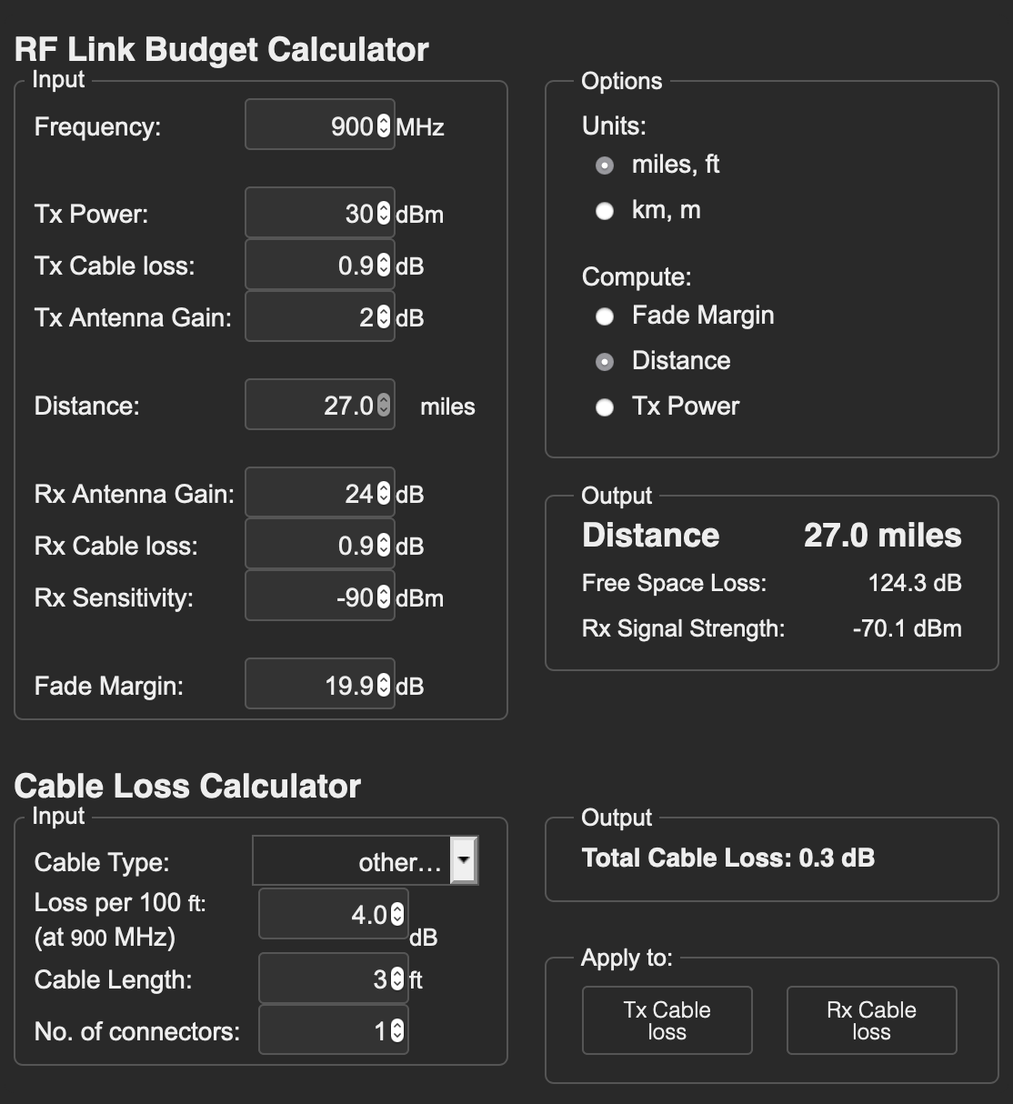
Link Budget
Based upon transmitter power, frequency, fade margin, gain, cable loss, and receiver sensitivity:
The only information we were unable to locate was the sensitivity of the receiver antenna that will be mounted on a tripod
Coaxial cable loss is negligible, as none of our cords are over 1ft. Do not expect any measurable loss of signal in that transmission process
The ground antenna has sensitivity based upon its height and directional capability

Slide 6

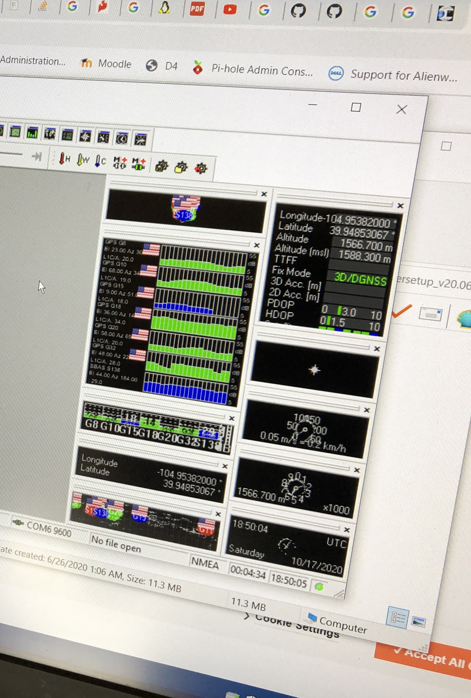
GPS Module
Model - GPS Module GPS NEO-6M:
Provides GPS data to allow the team to occasionally direct the antenna to continually monitor and pick up signal from the payload
This GPS will be able to serve also in the final prototype to be delivered at the end of the project
Data is transmitted, alongside the temperature and altitude from the payload to the ground station

Slide 7
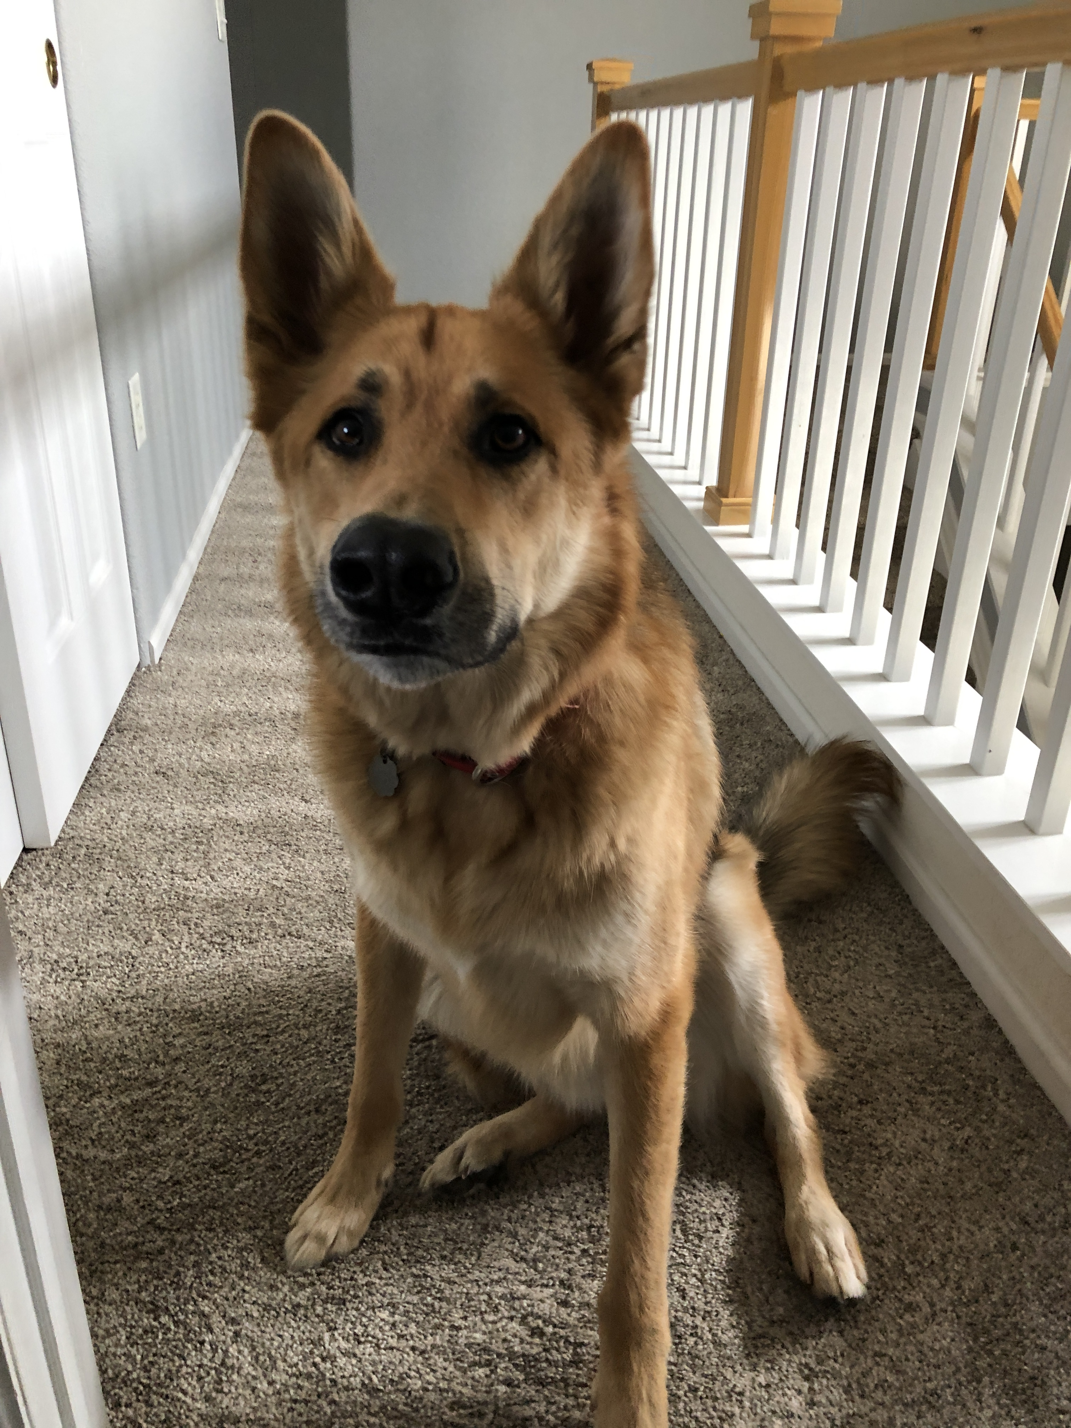
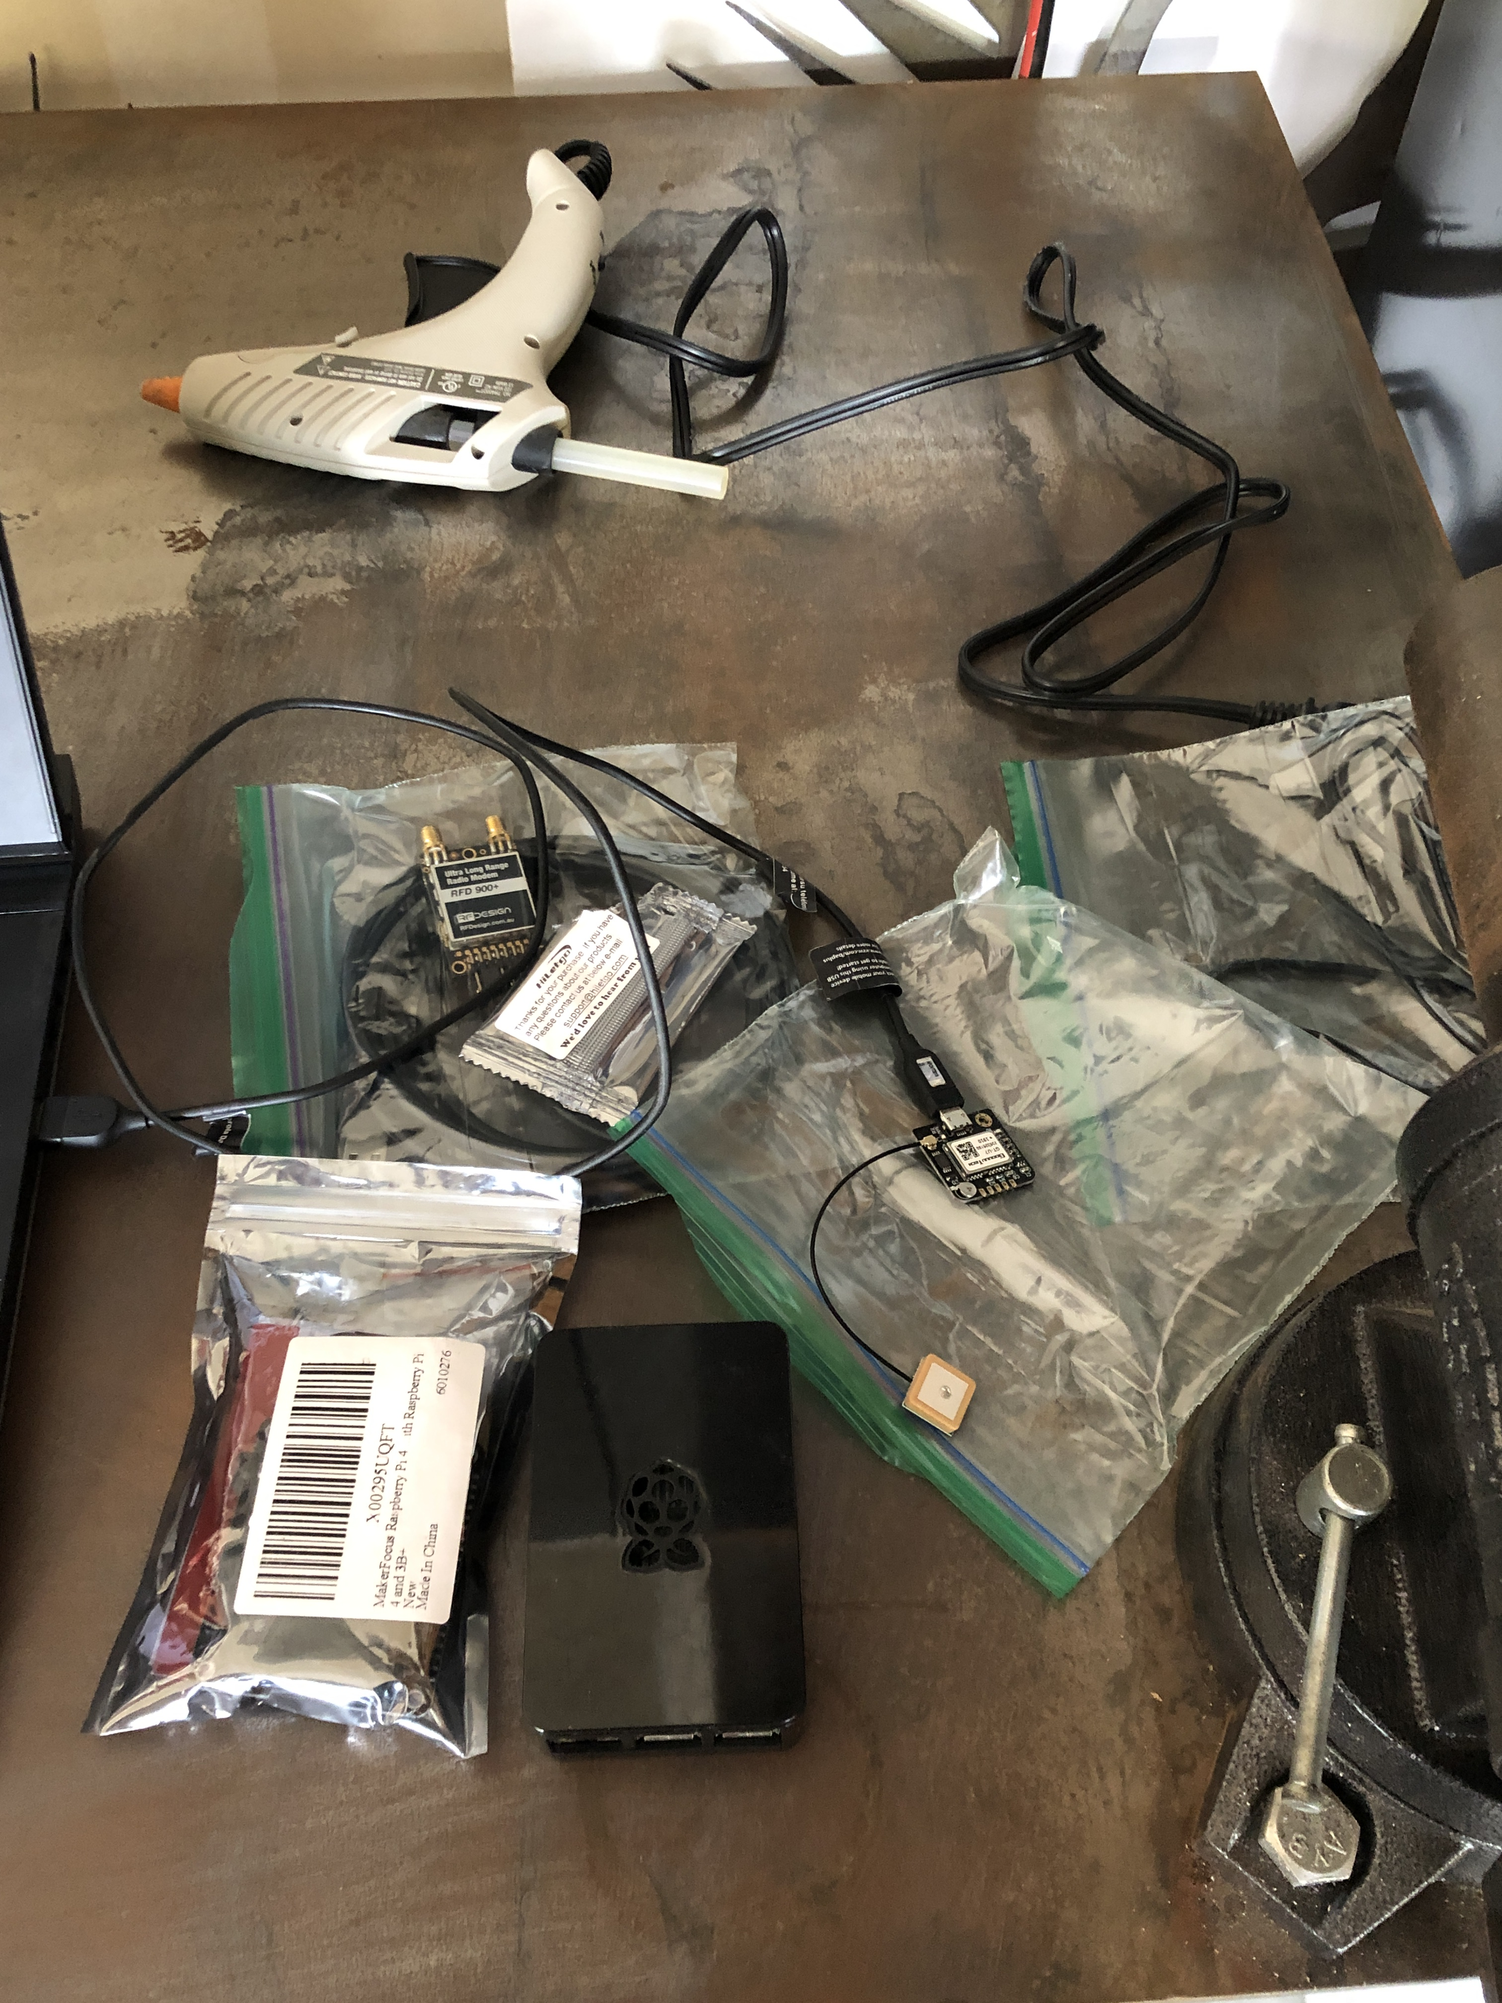
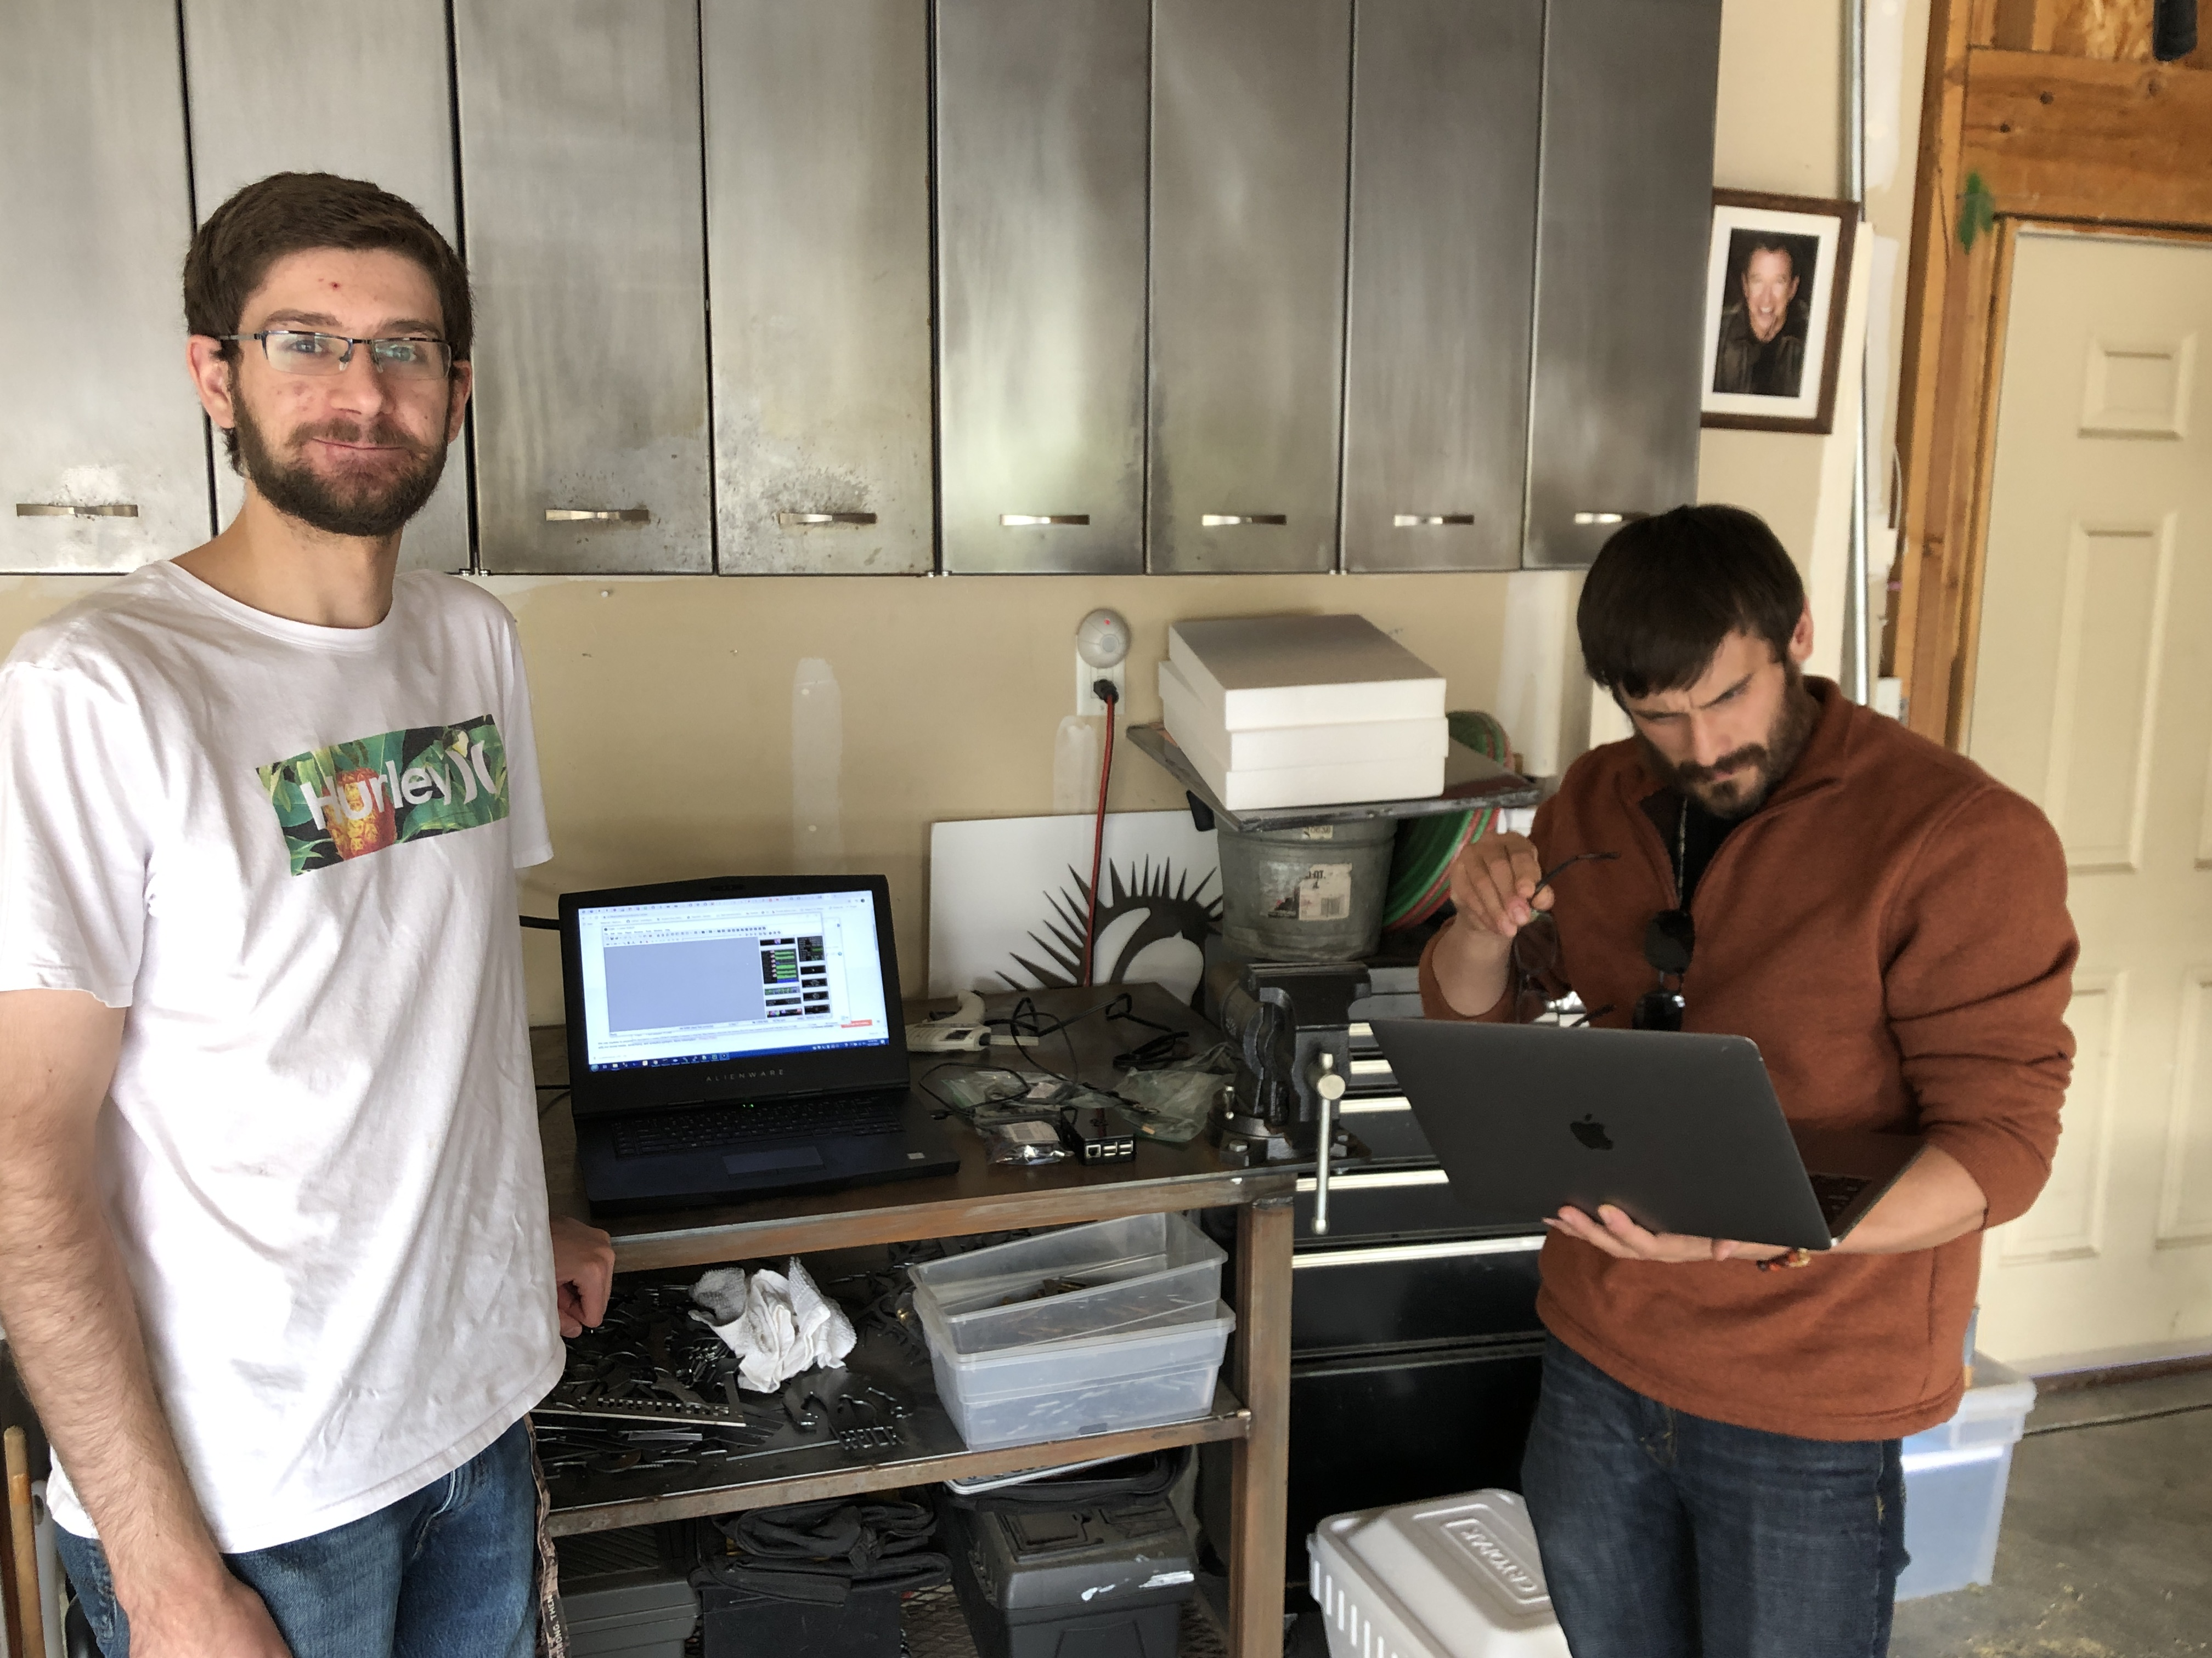
Build Day
Referenced all previous research
Battery capability
Build limitations and weight restrictions
Temperature of internal components, heat generated by Raspberry pi
Completed Payload build, to be delivered and tested again with the AES and EOSS

Slide 8
What’s Next?
Deliver payload for final evaluation to AES department and EOSS for final round of testing
Integrate and test new antenna to pick up a greater range of signal from the payload
Battery test for payload and expected run time under full load (GPS, Radio Transmitter)
Launch on October 31st
Adjust components, potentially build a motor and some software to track the payload as it travels (this will be necessary for an actual CubeSat)

